Slide 1
CPSC 3720: Lecture 3: Software Planning & Process
Eileen T. Kraemer and Murali Sitaraman, Clemson
E-mails: etkraem@clemson.edu and murali@Clemson.edu
Fall 2018 version
Some of the lecture slides have benefitted from the findings of grants from the US National Science Foundation.
Notes:
Allow 15 minutes for lifecycle quiz

Slide 2
Software Lifecycle Phases
Requirements analysis
Design and specification
Implementation
Quality Assurance
Maintenance

Slide 3
Project Planning
Predictive planning
Adaptive planning

Slide 4
Project Planning
Understand initial requirements and identify significant tasks
Remember the bottom line: High quality software on time on budget
Budget: Do cost estimates
Time: Set up project milestones

Slide 5
Cost Estimation
Depends on prior project experiences and backgrounds of personnel
COCOMO (Constructive Cost Estimation Model)
Other cost estimation models

Slide 6
COCOMO
developed by Barry W. Boehm in the late 1970s
Software Engineering Economics (1981)
Looked at codes with 2K to 100K LoC
Assembly, PL/I
Waterfall model

Slide 7
COCOMO II
Also Boehm
Developed ‘95, published 2000
Includes agile development process*
Based on:
more projects
Desktop applications vs. mainframe/batch
Reuse
Off-the-shelf components
* In agile development processes solutions evolve through collaborative efforts of cross-functional teams.

Slide 8
COCOMO
Three levels:
Basic
Good for quick/early/order of magnitude estimates
Effort and cost as f(program_size)
Program size expressed in SLOC, KLOC (source lines of code, thousands…)
Intermediate
Includes factors that account for differences in project attributes (cost drivers)
Detailed
Accounts for influence of project phase

Slide 9
COCOMO
Deals with three kinds of projects
Organic projects
"small" teams with "good" experience working with "less than rigid" requirements
Semi-detached projects
"medium" teams with mixed experience working with a mix of rigid and less than rigid requirements
Embedded projects
developed within a set of "tight" constraints. It is also combination of organic and semi-detached projects.(hardware, software, operational, ...)

Slide 10
COCOMO
Effort Applied (E) = a_{b}(KLOC)^{b}_{b} [ person-months]
Development Time (D) = c_{b}(Effort Applied)^{d}_{b} [months]
People required (P) = Effort Applied / Development Time [count]
Co-efficients from original analysis:
Software project | a_{b} | b_{b} | c_{b} | d_{b}
Organic | 2.4 | 1.05 | 2.5 | 0.38
Semi-detached | 3.0 | 1.12 | 2.5 | 0.35
Embedded | 3.6 | 1.20 | 2.5 | 0.32

Slide 11
Exercise – Basic COCOMO
You are asked to do cost estimation using basic COCOMO for a medium team with mixed experience working on a software development effort that will require 200,000 lines of code.
What do you predict will be required for the effort applied?
How long will the project take to develop?
How many people are required?

Slide 12
COCOMO - Intermediate
Includes “cost drivers”
Product attributes
Required software reliability, Size of application database, Complexity of the product
Hardware attributes
Run-time performance constraints, Memory constraints, Volatility of the virtual machine environment, Required turnabout time
Personnel attributes
Analyst capability, Software engineering capability, Applications experience, Virtual machine experience, Programming language experience
Project attributes
Use of software tools, Application of software engineering methods, Required development schedule

Slide 13
COCOMO - Detailed
Uses different effort multipliers for each cost driver attribute depending on phase:
Planning & requirements
Systems design
Detailed design
Module code & test
Integration & test
…

Slide 14
Other cost estimation approaches:
COSYMO
Evidence-based Scheduling
Function Point Analysis
Parametric Estimation
ITK
Putnam model
Others …

Slide 15
Process Models
Linear
Iterative

Slide 16
Process Models
Linear
Classical Waterfall Model
Iterative

Slide 17
Classical Waterfall Model
Requirements Analysis
Design & Specification
Implementation
Quality Assurance
Maintenance
Notes:
Project progresses through sequence of steps
At end of each stage, a review is conducted to determine if project is ready to advance to next stage.
Performs well for projects in which there is a stable product definition, the domain is well-known, and the technologies involved are well-understood
in such project, waterfall helps you to find errors in early stages, when they are much less costly to fix

Slide 18
Linear Process Models
Classical Waterfall model
Advantages:
Allows for predictive planning (reading)
Allows to find errors early when they are less costly to fix
Disadvantages: No feedback
Not flexible
Difficult to fully specify requirements at start of project
i.e., Realistic software processes do not work in a linear fashion

Slide 19
Iterative Process Models
Iterative process models (listed on the next slide)
Advantages: Allow for adaptive planning (reading)
Advantages: Feedback
Disadvantages:
Since things change, it is difficult to stick to plans
But there is no real alternative

Slide 20
Iterative Process Models
Spiral Process Model
Incremental Process Model
Rational Unified Process (RUP) Model
Agile Models
Various others, including combinations of the above

Slide 21
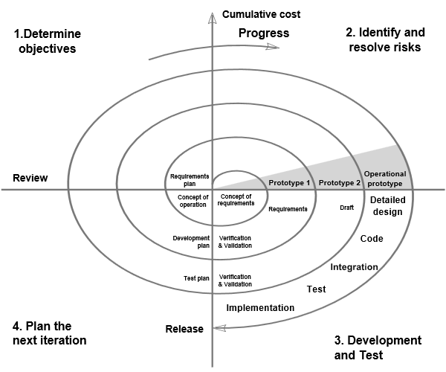
Spiral Process Model
Notes:
In 1988, Barry Boehm published a formal software system development "spiral model," which combines some key aspect of the waterfall model and rapid prototyping methodologies, in an effort to combine advantages of top-down and bottom-up concepts. It provided emphasis in a key area many felt had been neglected by other methodologies: deliberate iterative risk analysis, particularly suited to large-scale complex systems.
The basic principles are:^{[1]}
* Focus is on risk assessment and on minimizing project risk by breaking a project into smaller segments and providing more ease-of-change during the development process, as well as providing the opportunity to evaluate risks and weigh consideration of project continuation throughout the life cycle.
* "Each cycle involves a progression through the same sequence of steps, for each part of the product and for each of its levels of elaboration, from an overall concept-of-operation document down to the coding of each individual program."^{[9]}
* Each trip around the spiral traverses four basic quadrants:
(1) determine objectives, alternatives, and constraints of the iteration;
(2) evaluate alternatives; Identify and resolve risks;
(3) develop and verify deliverables from the iteration; and
(4) plan the next iteration.^{[10]}
Begin each cycle with an identification of stakeholders and their "win conditions", and end each cycle with review and commitment.^{[11]}

Slide 22
Software Risk & Risk Mgmt
Risk:
expectation of loss, problem that may occur
Causes:
lack of information, control or time
Examples of loss:
increase in production cost
development of poor quality software
unable to complete the project on time.

Slide 23
Software risks
Why?
future is uncertain
many known and unknown things that cannot be incorporated in the project plan
Two types:
internal risks that are within the control of the project manager
external risks that are beyond the control of project manager

Slide 24
Risk Management
Identify the risk
Reduce the impact of risk
Reduce probability or likelihood of risk
Risk monitoring

Slide 25
Sources of risk
Known knowns
Known unknowns
Unknown unknowns

Slide 26
Sources of risk
Known knowns
software risks that are facts known to the team & the project
e.g. -- having too few developers can delay the project delivery
described and included in the Project Management Plan

Slide 27
Sources of risk
Known unknowns
risks that the project team is aware of but it is unknown whether such risk exists in the project
Example: Know that good communication with client is needed to capture requirements, but may be unknown whether the client has communicated all the information needed

Slide 28
Sources of risk
Unknown Unknowns
risks about which the organization has no idea
generally related to technology
suddenly exposes project to absolutely unknown risks

Slide 29
Spiral Process Model
Notes:
Advantages:
* risk reduction
* functionality can be added in later iterations
* software produced early
Disadvantages:
* risk analysis requires highly specific expertise
* highly dependent on risk analysis
* complex

Slide 30
Evolutionary prototyping
Pros:
* Immediate feedbak
Cons:
* Difficult to plan
* Code & fix / hacking approach

Slide 31
Rational Unified Process Model
Unified Process –
popular iterative/incremental software process framework
Four phases:
Inception
Elaboration (milestone)
Construction (release)
Transition (final production release)
Rational Unified Process (RUP)
A version of Unified Process created by the Rational Software Corp., a division of IBM
an adaptable framework, intended to be tailored by the software project teams that select elements that are appropriate for their needs

Slide 32
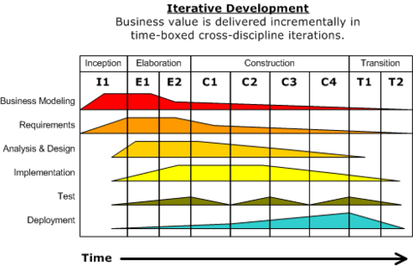
Rational Unified Process
Notes:
In each phase, perform standard SE activities, but to different extents in different phases

Slide 33
Agile Models
Cross-functional teams
Requirements & solutions evolve
Adaptive planning, evolutionary development, early delivery, continuous improvement
Manifesto:
Individuals and Interactions more than processes and tools
Working Software more than comprehensive documentation
Customer Collaboration more than contract negotiation
Responding to Change more than following a plan
Examples:
Scrum
Kanban

Slide 34
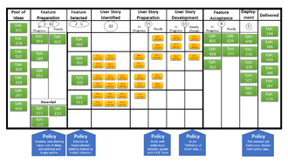
Agile Models
Scrum:
teams of 3-9 developers
work in 1 to 4 week cycles (sprints)
Check progress daily in 15 minute standup meetings
Deliver workable software after every sprint
Kanban
method for visualizing the flow of work
Goal is to balance demand with capacity, spot bottlenecks
Pull versus push

Slide 35
Agile : TDD
Fail

Slide 36
Agile : TDD
Fail
Pass

Slide 37
Agile : TDD
Fail
Refactor
Pass

Slide 38
How to choose?
Requirements understanding
Expected lifetime
Risk
Schedule constraints
Interaction with management/customers
Experience

Slide 39
Process Vs. Product Discussion
Notes:
Allow at least 15 minutes. Student groups of 3 take a stand: Process is more important or Product is more important. Make sure there are enough groups for both sides. Have Process group call out their first key point. Product group then does two. Process group does two. Then Product group does one. Conclude noting that they are both important!

Slide 40
Process Quality: CMM
CMM = Capability Maturity Model
Watts Humphrey @ CMU’s SEI
Managing the Software Process (1989)
Levels:
Initial
Repeatable
Defined
Managed
Optimizing

Slide 41
CMM Characterization of Ratings
Initial
Ad hoc
Repeatable
A repeatable process is in place
Defined
Above + Standards are in place
Managed
Above + Metrics collection is in place
Optimizing
Above + Continuous improvement methods are in place

Slide 42
Requirements Engineering
Requirements elicitation
Requirements modeling
Requirements analysis
Requirements documentation
Requirements validation
Requirements management
Notes:
Steps are interleaved – not strictly done in this order

Slide 43
Requirements Elicitation
Identifying stakeholders
Understanding goals, business case, priorities, and risks
Interviews

Slide 44
Requirements Elicitation
Making a business case
Understanding priorities
Must have features
Bonus features
Resolving conflicts
When different stakeholders communicate different priorities how do you decide which are true priorities?
Understanding risks
What do we mean by “risk”?
May have to determine risks based on responses to interview questions; may not have direct answers

Slide 45
Types of Interview Questions
Questions concerned with the system to be developed
Questions concerning the context/scope of the system
Meta-questions
Notes:
Use this slide to generate a discussion. Use the next slide as a summary.

Slide 46
Types of Interview Questions
Questions concerned with the functionality of the system to be developed
Goal is to understand both functional and non-functional requirements, such as performance
Examples
Questions concerning the context/scope of the system
Physical system, the environment where the system will be used, deadlines, etc.
Meta-questions
Questions about questions
Are we asking the right questions? Are we talking with the right people

Slide 47
Team Formation
Team projects are weighted heavily
Three members per team, no more, no less; If the number of students is not divisible by 3, it may be necessary to have one or two teams of 2 students
Talk to your friends and form teams by next week
If you don’t take the initiative, you may be assigned to a team randomly at the instructor’s discretion
Notes:
Due before the next class

